Slide 1
Module 5 Live Session
IMT 575

Slide 2
Today
Lab 4 Questions
The Only Reason Text is Hard: Representing Text as Vectors
Using Pre-trained embeddings (Part 3 of Lab 5)
Bag of Words and TF-IDF (Part 2 of Lab 5)
Latent Semantic Analysis
Word2Vec and Doc2Vec (pre-trained embeddings)

Slide 3
Some Text Analysis Tasks
Application | Input | Output
Sentiment Analysis | Tweet | {positive, negative, neutral}
Topic Labeling | Article | {Sports, News, …}
Machine Translation | Sentence in French | Sentence in Arabic
Question Answering | Question | Answer

Slide 4
Example: Document Classification
“The Mars Rover discovered organic molecules on Sunday”
“The Falcons trounced the Saints on Sunday”
Sports
Science

Slide 5
“The Mars Rover discovered organic molecules on Sunday”
Some
Function
Science

Slide 6
Machine Learning usually implies…
“The Mars Rover discovered organic molecules on Sunday”
Some Linear Algebra
Function
Science

Slide 7
“The Mars Rover discovered organic molecules on Sunday”
Some Linear Algebra
Function
Science
Notes:
So we need vectors in, and vectors out

Slide 8
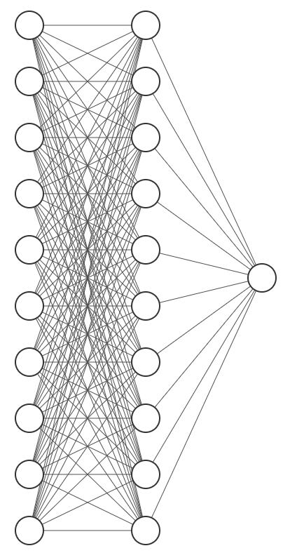
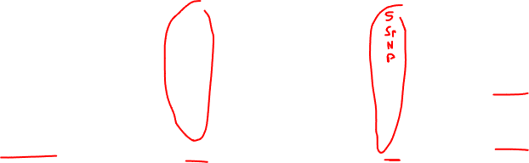
“The Mars Rover discovered organic molecules on Sunday”
Some Linear Algebra
Function
Science
Review: How do we decode a vector into a class label?
Notes:
Softmax

Slide 9
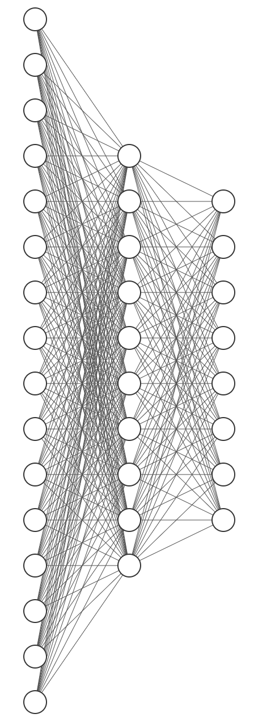
“The Mars Rover discovered organic molecules on Sunday”
Some Linear Algebra
Function
Science
Today: How do we encode text into a vector?
Notes:
Softmax

Slide 10
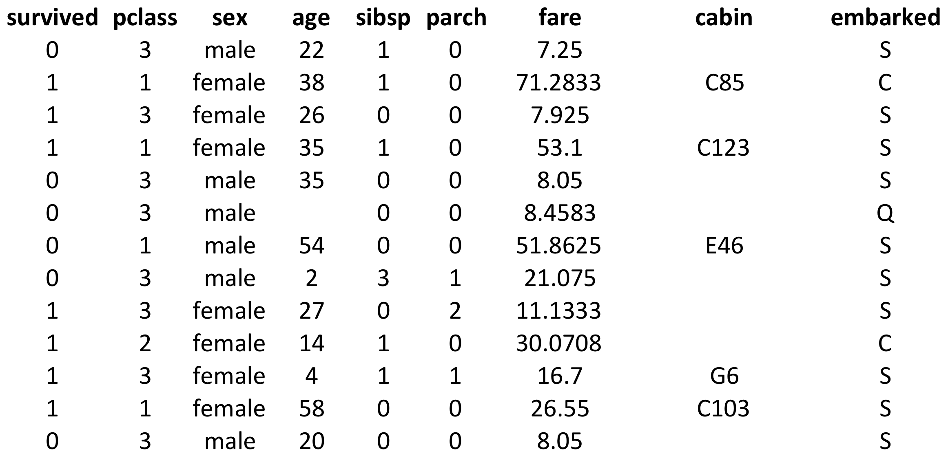
Representing Data: Tables
How do we make this data available to machine learning?
Aside: Responsibility issues in this dataset?
Notes:
survival Survival
(0 = No; 1 = Yes)
pclass Passenger Class
(1 = 1st; 2 = 2nd; 3 = 3rd)
name Name
sex Sex
age Age
sibsp Number of Siblings/Spouses Aboard
parch Number of Parents/Children Aboard
ticket Ticket Number
fare Passenger Fare
cabin Cabin
embarked Port of Embarkation
(C = Cherbourg; Q = Queenstown; S = Southampton)

Slide 11
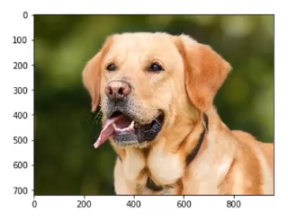
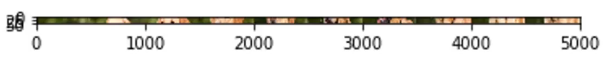
Representing Data: Images
How do we make this data available to machine learning?

Slide 12
Representing Data: Text
“The Mars Rover discovered organic molecules on Sunday”
???

Slide 13

Today: Representing Text as a Vector
Bag of Words
Latent Semantic Analysis
Word2Vec
Others:
GloVe (Stanford, ~2016)
Fasttext (Facebook, ~2017)
ELMo (AI2 & UW, ~2018)
BERT (Google, ~2018)
Universal Sentence Encoder (Google, ~2018)

Slide 14
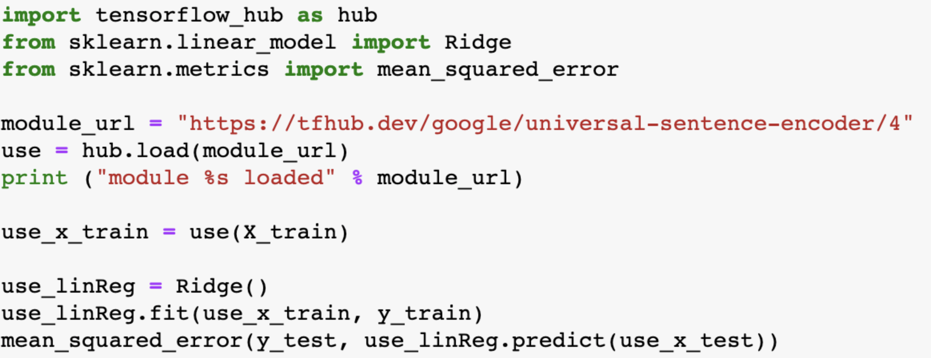
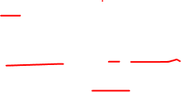
Using Pre-trained embeddings: Universal Sentence Encoder
Part 3 of Lab 5!
Load pre-trained model
Get pre-trained embeddings
Train ordinary classifier

Slide 15
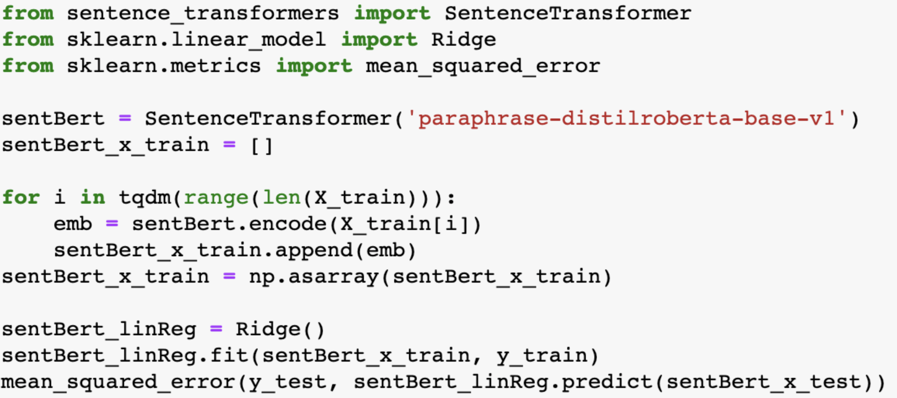
Using Pre-trained embeddings: BERT Sentence Transformer
Load pre-trained model
Get pre-trained embeddings
Train ordinary classifier

Slide 16
Pre-processing: Some possible steps
Remove all irrelevant characters such as any non alphanumeric characters
Tokenize your text by separating it into individual words
Remove words that are not relevant, such as “@” twitter mentions or urls
Remove short words
Convert all characters to lowercase, in order to treat words such as “hello”, “Hello”, and “HELLO” the same
Other possibilities:
Consider combining misspelled or alternately spelled words to a single representation (e.g. “cool”/”kewl”/”cooool”)
Consider lemmatization (reduce words such as “am”, “are”, and “is” to a common form such as “be”)

Slide 17
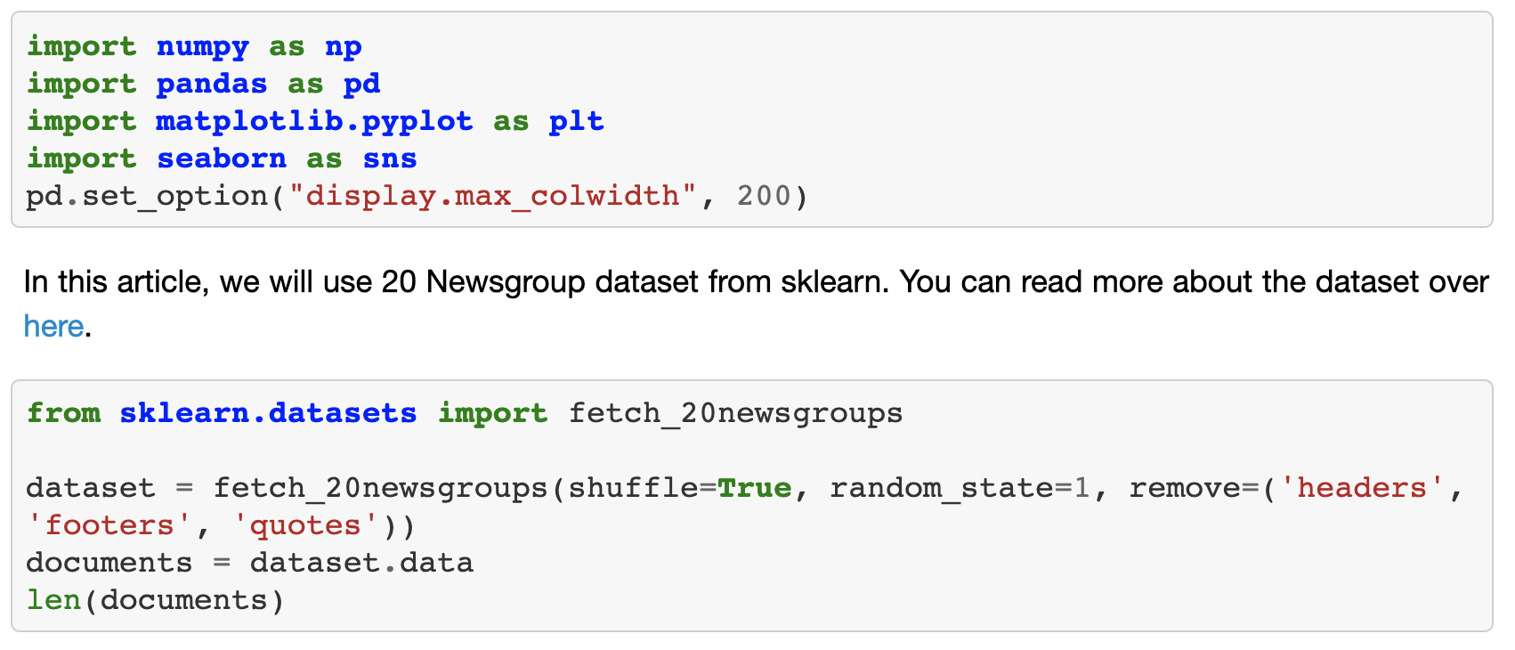
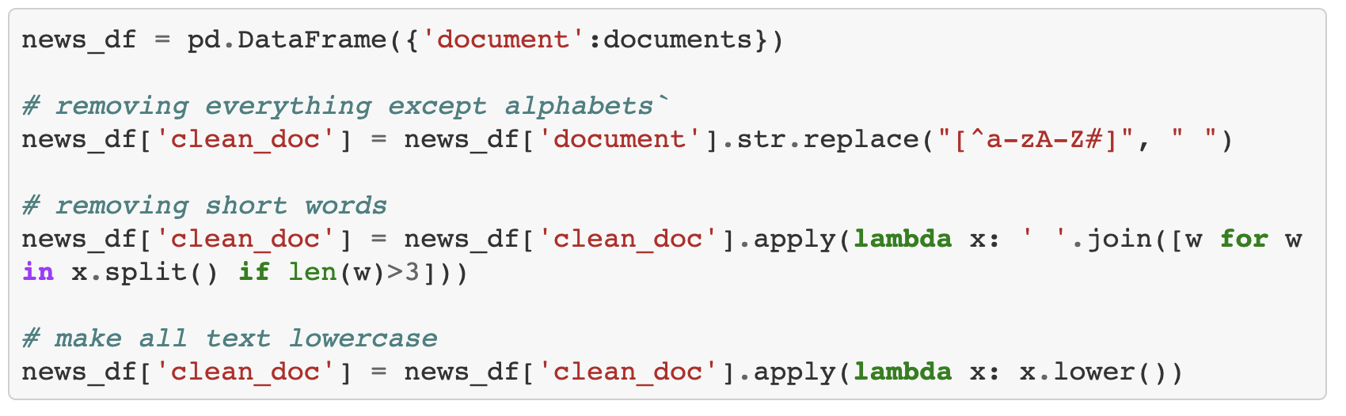
https://www.analyticsvidhya.com/blog/2018/10/stepwise-guide-topic-modeling-latent-semantic-analysis/

Slide 18
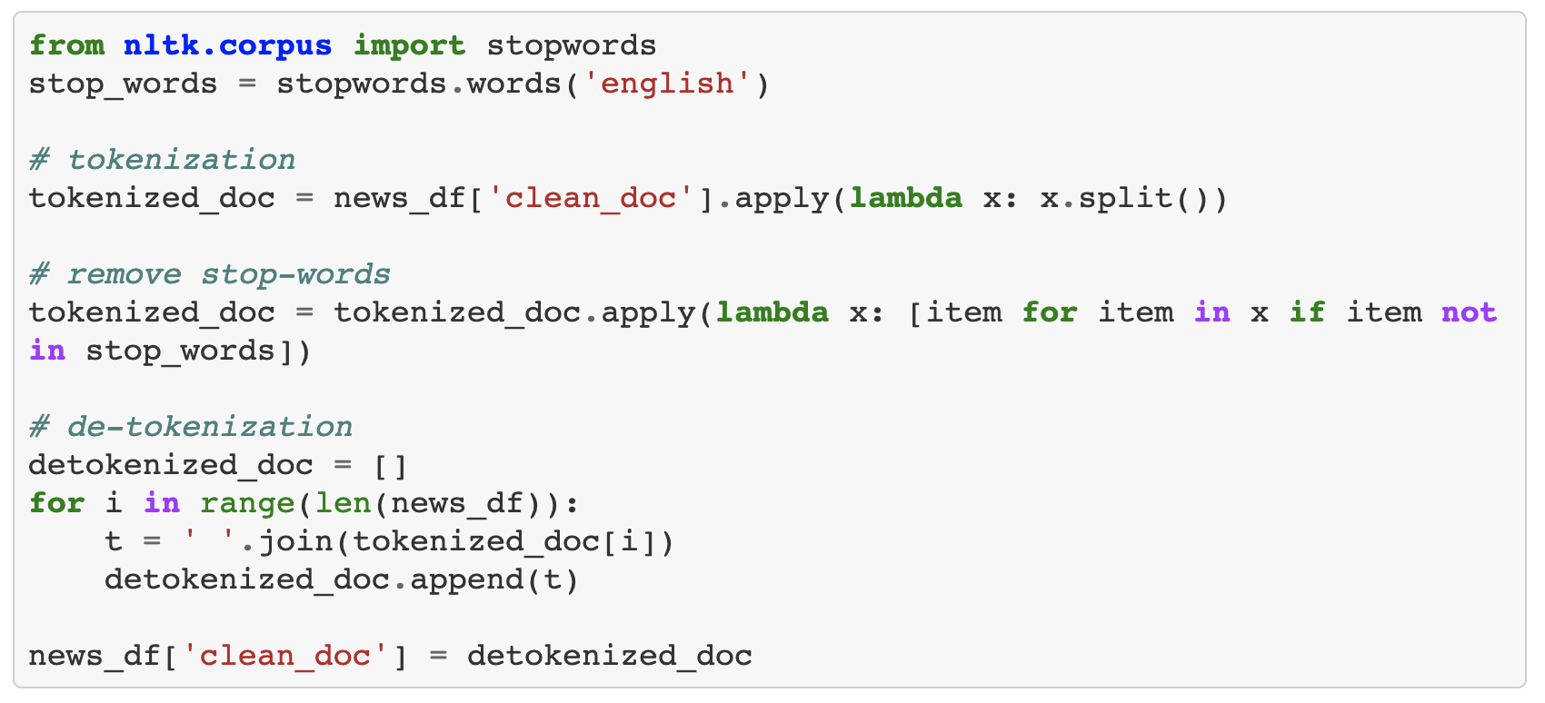
Removing stopwords
https://www.analyticsvidhya.com/blog/2018/10/stepwise-guide-topic-modeling-latent-semantic-analysis/

Slide 19
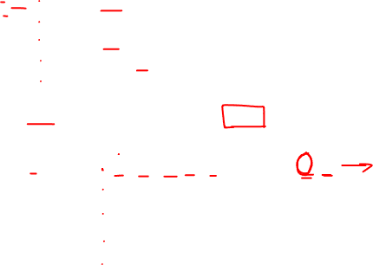
First attempt: Bag-of-words
d1 : Romeo and Juliet.
d2 : Juliet: O happy dagger!
d3 : Romeo died by dagger.
d4 : “Live free or die”, that’s the New-Hampshire’s motto.
d5 : Did you know, New-Hampshire is in New-England.
dagger die new-hampshire free happi live new-england motto romeo juliet
d1
d2
d3
d4
d5
[0, 0, 0, 0, 0, 0, 0, 0, 1, 1]
[1, 0, 0, 0, 1, 0, 0, 0, 0, 1]
[1, 1, 0, 0, 0, 0, 0, 0, 1, 0]
[0, 1, 1, 1, 0, 1, 0, 1, 0, 0]
[0, 0, 1, 0, 0, 0, 1, 0, 0, 0]

Slide 20
Example dataset: Disasters on Social Media
Contributors looked at over 10,000 tweets culled with a variety of searches like “ablaze”, “quarantine”, and “pandemonium”, then noted whether the tweet referred to a disaster event (as opposed to a joke with the word or a movie review or something non-disastrous).
Input: Tweet
Output: “disaster” or “not disaster”

Slide 21
One-hot-encoding / bag-of-words
dataset: Disaster
Repr: bag-of-words
visualization: PCA
separation is not very good.
Conclusion: It will be difficult to use this representation to recognize disasters

Slide 22
Problem 1 with bag of words: frequency
Common words will have very high frequencies, but they don’t help distinguish different documents
“you” “say” “with”
may not be stopwords
We want to weight the frequency by how often we expect to see it.

Slide 23

TF-IDF
TF = Term Frequency of term t in document d
Many variants exist
binary (1 if present, 0 otherwise)
f_{t,d} = count of occurrences of t in d
f_{t,d} / |d| (normalized by the size of the document)
log(1 + f_{t,d}) (give less weight to high-frequency terms)
IDF = Inverse Document Frequency
log ( N / # of documents containing t )
Simple TF-IDF = f_{t,d} * log(N / # of documents containing t)

Slide 24
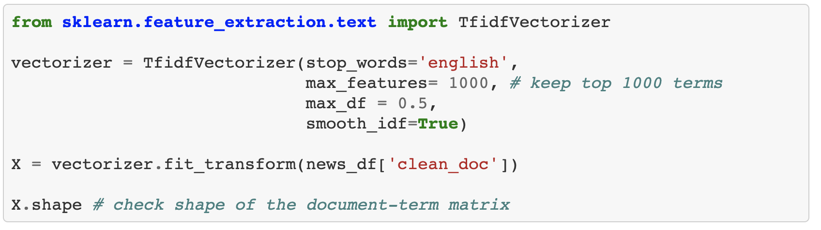

Part 2 of Lab 5!
Applying TF-IDF
https://www.analyticsvidhya.com/blog/2018/10/stepwise-guide-topic-modeling-latent-semantic-analysis/

Slide 25
dataset: Disaster
Repr: TF-IDF
visualization: PCA
separation is better, but still not great
Conclusion: It will still be difficult to use this representation to recognize disasters

Slide 26
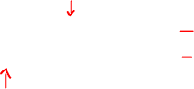
Problem 2 with bag of words: semantics
motel [0 0 0 0 0 0 0 0 0 0 1 0 0 0 0]
hotel [0 0 0 0 0 0 0 3 0 0 0 0 0 0 0]
vectors are orthogonal: they are totally dissimilar
but hotel is semantically similar to motel
we will fix this later

Slide 27
Latent Semantic Analysis

Slide 28
Example
d1 : Romeo and Juliet.
d2 : Juliet: O happy dagger!
d3 : Romeo died by dagger.
d4 : “Live free or die”, that’s the New-Hampshire’s motto.
d5 : Did you know, New-Hampshire is in New-England.
dagger die new-hampshir free happi live new-england motto romeo juliet
d1
d2
d3
d4
d5
[0, 0, 0, 0, 0, 0, 0, 0, 1, 1]
[1, 0, 0, 0, 1, 0, 0, 0, 0, 1]
[1, 1, 0, 0, 0, 0, 0, 0, 1, 0]
[0, 1, 1, 1, 0, 1, 0, 1, 0, 0]
[0, 0, 1, 0, 0, 0, 1, 0, 0, 0]

Slide 29
Latent Semantic Indexing
Task: Lookup documents by keyword
Naïve Method:
score = sum of frequency of query terms
query: die, dagger
related?
d1 : Romeo and Juliet.
d2 : Juliet: O happy dagger!
d3 : Romeo died by dagger.
d4 : “Live free or die”, that’s the New-Hampshire’s motto.
d5 : Did you know, New-Hampshire is in New-England.

Slide 30
Steps in Latent Semantic Analysis
Pre-process
Remove stopwords
Stemming
Construct document vectors, build matrix
Dimension reduction – a “latent” space
using SVD
Check similarity in the latent space

Slide 31
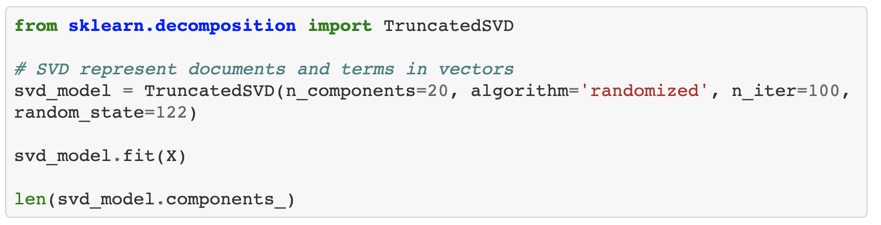
https://www.analyticsvidhya.com/blog/2018/10/stepwise-guide-topic-modeling-latent-semantic-analysis/

Slide 32
Singular Value Decomposition: Given M, find U, Σ, V such that M = U ΣV*
V* = transpose of V
In our case:
Each row of W is a term
Each column is a document
Each cell is TF in that document
Landuaer and Dumais 1997
src: wikipedia

Slide 33
SVD applied to term-document matrix: Latent Semantic Analysis
Deerwester et al (1988)
If instead of keeping all m dimensions, we just keep the top k singular values. Let’s say 300.
The result is a least-squares approximation to the original matrix
Each row of W is a term
Each column is a document
Each cell is TF in that document

Slide 34
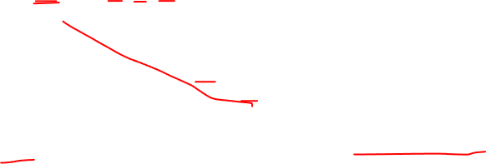
Singular Value Decomposition
M = UΣV^{T}
Σ =
dΣ =
[ 0.9337699 0.81287533 0.61612294 0.56266546 0.4249963 ]
reduce dimensions
dΣ_{r} =
[ 0.9337699 0.81287533 0.61612294 0.00000000 0.0000000 ]
M_{lsa} = UΣ_{r}V^{T}

Slide 35

d1 : Romeo and Juliet.
dagger die new-hampshir free happi live new-england motto romeo juliet
[+0.00 +0.00 +0.00 +0.00 +0.00 +0.00 +0.00 +0.00 +0.46 +0.46 ]
[+0.31 +0.00 +0.00 +0.00 +0.54 +0.00 +0.00 +0.00 +0.00 +0.31 ]
[+0.31 +0.31 +0.00 +0.00 +0.00 +0.00 +0.00 +0.00 +0.31 +0.00 ]
[+0.00 +0.18 +0.18 +0.32 +0.00 +0.32 +0.00 +0.32 +0.00 +0.00 ]
[+0.00 +0.00 +0.46 +0.00 +0.00 +0.00 +0.80 +0.00 +0.00 +0.00 ]
[+0.11 +0.10 -0.01 -0.04 -0.01 -0.04 +0.01 -0.04 +0.48 +0.35 ]
[+0.32 +0.01 -0.00 -0.00 +0.54 -0.00 +0.00 -0.00 +0.00 +0.30 ]
[+0.10 +0.13 +0.03 +0.07 +0.02 +0.07 -0.02 +0.07 +0.27 +0.19 ]
[+0.06 +0.24 +0.18 +0.30 -0.01 +0.30 +0.01 +0.30 +0.01 -0.06 ]
[-0.01 -0.01 +0.46 +0.00 +0.00 +0.00 +0.80 +0.00 -0.00 +0.01 ]
M
aha!
d1
M_{lsa}
dΣ_{r} = [ 0.9337699 0.81287533 0.61612294 0.56266546 0.000000 ]

Slide 36
d1 : Romeo and Juliet.
dagger die new-hampshir free happi live new-england motto romeo juliet
[+0.00 +0.00 +0.00 +0.00 +0.00 +0.00 +0.00 +0.00 +0.46 +0.46 ]
[+0.31 +0.00 +0.00 +0.00 +0.54 +0.00 +0.00 +0.00 +0.00 +0.31 ]
[+0.31 +0.31 +0.00 +0.00 +0.00 +0.00 +0.00 +0.00 +0.31 +0.00 ]
[+0.00 +0.18 +0.18 +0.32 +0.00 +0.32 +0.00 +0.32 +0.00 +0.00 ]
[+0.00 +0.00 +0.46 +0.00 +0.00 +0.00 +0.80 +0.00 +0.00 +0.00 ]
[+0.20 +0.09 +0.00 +0.02 +0.22 +0.02 -0.01 +0.02 +0.25 +0.30 ]
[+0.22 +0.02 -0.02 -0.06 +0.28 -0.06 +0.02 -0.06 +0.25 +0.35 ]
[+0.13 +0.12 +0.03 +0.09 +0.11 +0.09 -0.03 +0.09 +0.19 +0.18 ]
[+0.02 +0.24 +0.17 +0.28 -0.10 +0.28 +0.02 +0.28 +0.11 -0.04 ]
[-0.00 -0.01 +0.46 +0.01 +0.02 +0.01 +0.80 +0.01 -0.02 +0.00 ]
M
d1
M_{lsa}
Effect of reducing by 2 dimensions
dΣ_{r} = [ 0.9337699 0.81287533 0.61612294 0.000000 0.000000 ]

Slide 37
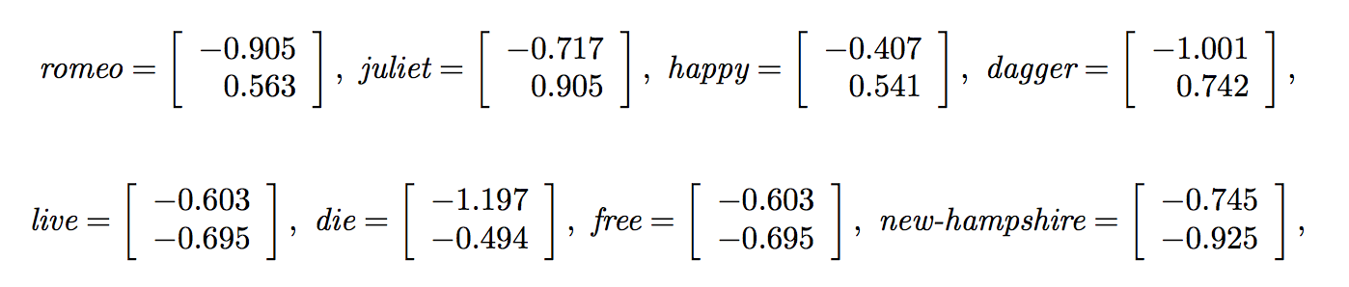

Interpretation: A “latent” space of concepts
M = UΣV^{T}
The documents are represented by the row vectors of UΣ
The terms are represented by the column vectors of ΣV^{T}

Slide 38

Application: Information Retrieval
q: “free dagger”
dagger die new-hampshir free happi live new-england motto romeo juliet
q
[1, 0, 0, 1, 0, 0, 0, 0, 0, 0]
Multiply q by Σ to get q’ in latent space
Compare this k-dimensional vector q’ with the k-dimensional document vectors to find the similar ones.

Slide 39
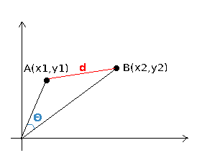
Similarity function
Euclidean distance? Cosine similarity?
Cosine = favors dominant components
Euclidean = difficult to interpret with sparse data, and high-dimensional data is always sparse
Euclidean
Cosine

Slide 40
Problems with Term-Document matrix
Co-occurrence in a large document doesn’t expose “local” semantic relationships
Words that co-occur “nearby” each other:
“Students in the course 575”
“An accident on highway 9”

Slide 41
Idea: Use “window” co-occurrence
Consider the “document” to be the previous seven words and the next seven words
Build a term co-occurrence matrix
Rows: Terms
Columns: Also Terms
Cells: The number of documents in which term i co-occurs with term j

Slide 42
d1 : Romeo and Juliet.
d2 : Juliet: O happy dagger!
d3 : Romeo died by dagger.
d4 : “Live free or die”, that’s the New-Hampshire’s motto.
d5 : Did you know, New-Hampshire is in New-England.
Window of size [-2, 2]
dagger
die
new-hampshir
free
happi
live
new-england
motto
romeo
juliet
dagger
die
new-hampshir
free
happi
live
new-england
motto
romeo
juliet
[0, 1, 0, 0, 1, 0, 0, 0, 0, 0]
[1, 0, 0, 1, 0, 0, 0, 0, 1, 0]
[0, 0, 0, 0, 0, 0, 1, 1, 0, 0]
[0, 1, 1, 1, 0, 1, 0, 1, 0, 0]
[1, 0, 0, 0, 0, 0, 0, 0, 0, 1]
[0, 1, 0, 1, 0, 0, 0, 0, 0, 0]
[0, 0, 1, 0, 0, 0, 0, 0, 0, 0]
[0, 0, 1, 0, 0, 0, 0, 0, 0, 0]
[0, 1, 0, 0, 0, 0, 0, 0, 0, 1]
[0, 0, 0, 0, 1, 0, 0, 0, 1, 0]

Slide 43
d1 : Romeo and Juliet.
d2 : Juliet: O happy dagger!
d3 : Romeo died by dagger.
d4 : “Live free or die”, that’s the New-Hampshire’s motto.
d5 : Did you know, New-Hampshire is in New-England.
[+0.00 +0.00 +0.00 +0.00 +0.00 +0.00 +0.01 +0.00 +0.00 +0.00 ]
[+0.00 +0.00 +0.00 +0.00 +0.00 +0.00 +0.01 +0.00 +0.00 +0.00 ]
[+0.00 +0.00 +0.01 +0.00 +0.00 +0.00 +0.02 +0.00 +0.00 +0.00 ]
[+0.00 +0.01 +0.08 +0.01 +0.00 +0.01 +0.13 +0.01 +0.00 +0.00 ]
[+0.01 +0.04 +0.48 +0.05 +0.00 +0.05 +0.78 +0.05 +0.01 +0.01 ]
dagger die new-hampshir free happi live new-england motto romeo juliet
d1
d2
d3
d4
d5
M_{lsa}
Effect of reducing by 4 dimensions
Σ_{r} = [ 0.9337699 0.000000 0.000000 0.000000 0.000000 ]

Slide 44
Distributional hypothesis
Word2vec
Skip-gram
CBOW
Doc2vec

Slide 45
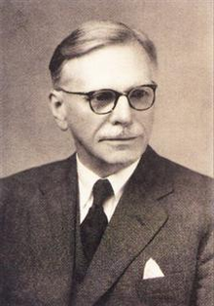
Distributional Hypothesis
“You shall know a word by the company it keeps”
(J. R. Firth 1957: 11)

Slide 46
Distributional similarity-based representations
government debt problems turning into banking crises as has happened in…
saying that Europe needs unified banking regulation to replace the hodgepodge
The context represents “banking” better than the word itself!
One of the most successful ideas of modern statistical NLP!
Adapted from Manning et al. CS276 - Information Retrieval and Web Search, Stanford Spring 2016

Slide 47
Representing words by its neighbors
Use co-occurrence matrix
Two options for context – document or window
Word-document co-occurrence matrix leads to general topics (sports terms will have similar entries)
“Latent Semantic Analysis”
Instead – window around each word captures syntactic and semantic information

Slide 48
“One-Hot Encoding” Drawbacks
No relationship between words
Each word is an independent unit vector
D(“cat”, “refrigerator”) = D(“cat”, “cats”)
D(“spoon”, “knife”) = D(“spoon”, “dog”)
In the ideal world…
Relationships between word vectors reflects relationships between words
Features of word embeddings reflect features of words

Slide 49
Word2Vec Intuition
Feature vectors of words should be meaningful
Train a neural network to perform a simple task
Hidden layer of neural network is a feature detector
Use hidden layer of the neural network as word embedding

Slide 50
Prediction-based models: An alternative way to get dense vectors
Skip-gram (Mikolov et al. 2013a) CBOW (Mikolov et al. 2013b)
Learn embeddings as part of the process of word prediction.
Train a neural network to predict neighboring words
Inspired by neural net language models.
In so doing, learn dense embeddings for the words in the training corpus.
Advantages:
Fast, easy to train (much faster than SVD)
Available online in the word2vec package
Including sets of pretrained embeddings!

Slide 52
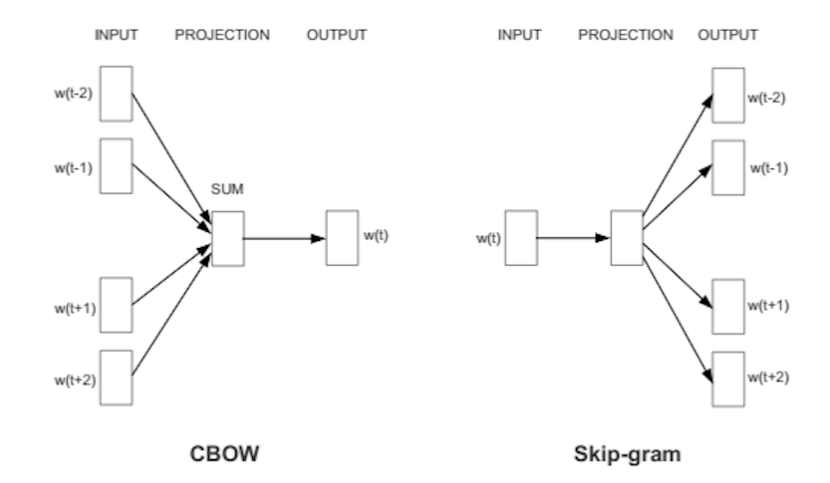
CBOW and Skip-gram
Predict target word from several input context words
Predict target context words from single input word
Both work!

Slide 53
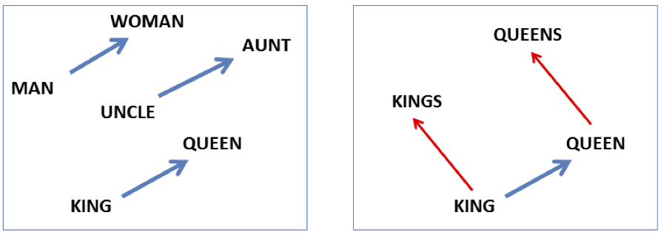
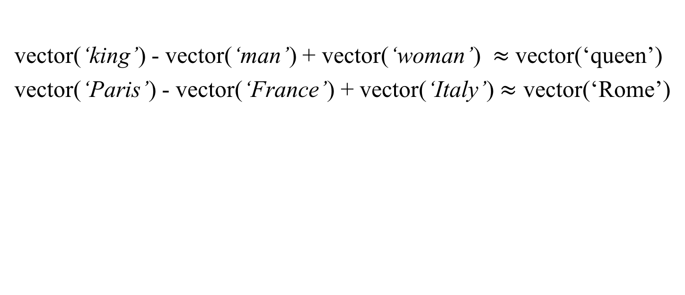
Embeddings capture relational meaning!
vector(‘king’) - vector(‘man’) + vector(‘woman’) $≈$vector(‘queen’)
vector(‘Paris’) - vector(‘France’) + vector(‘Italy’) $≈$ vector(‘Rome’)

Slide 54
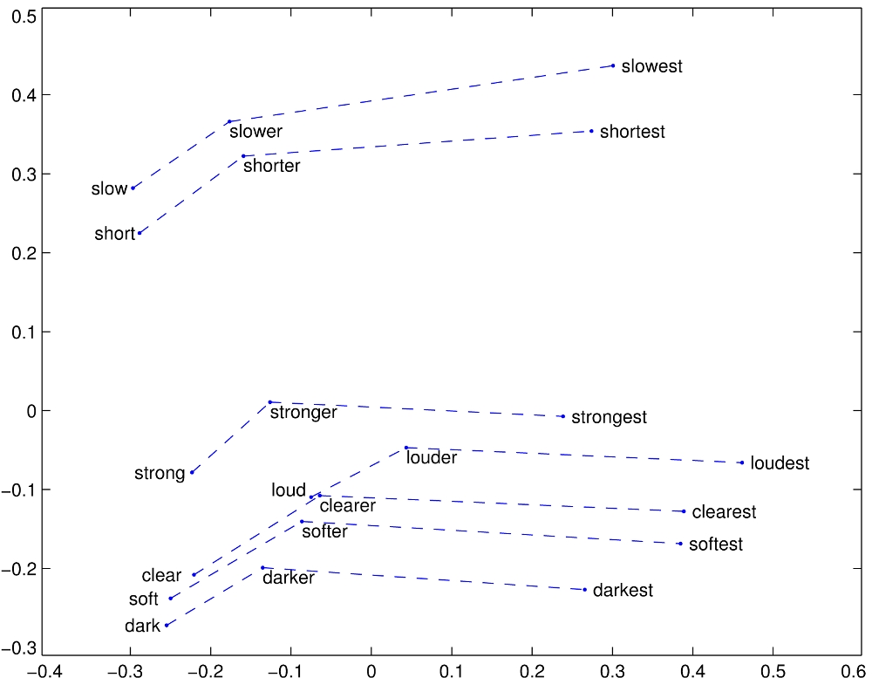

Embeddings capture relationships
GloVe vectors for comparative and superlative adjectives
http://nlp.stanford.edu/projects/glove/images/comparative_superlative.jpg

Slide 55
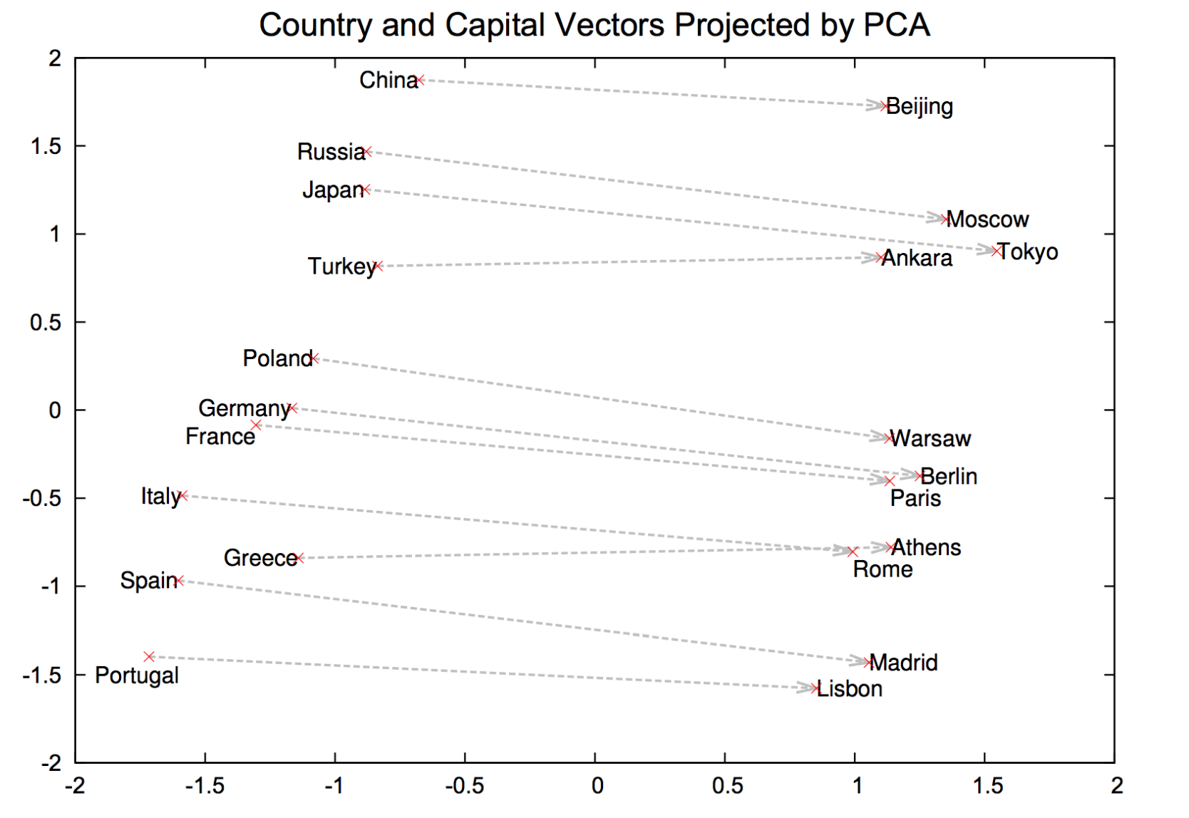

Slide 56
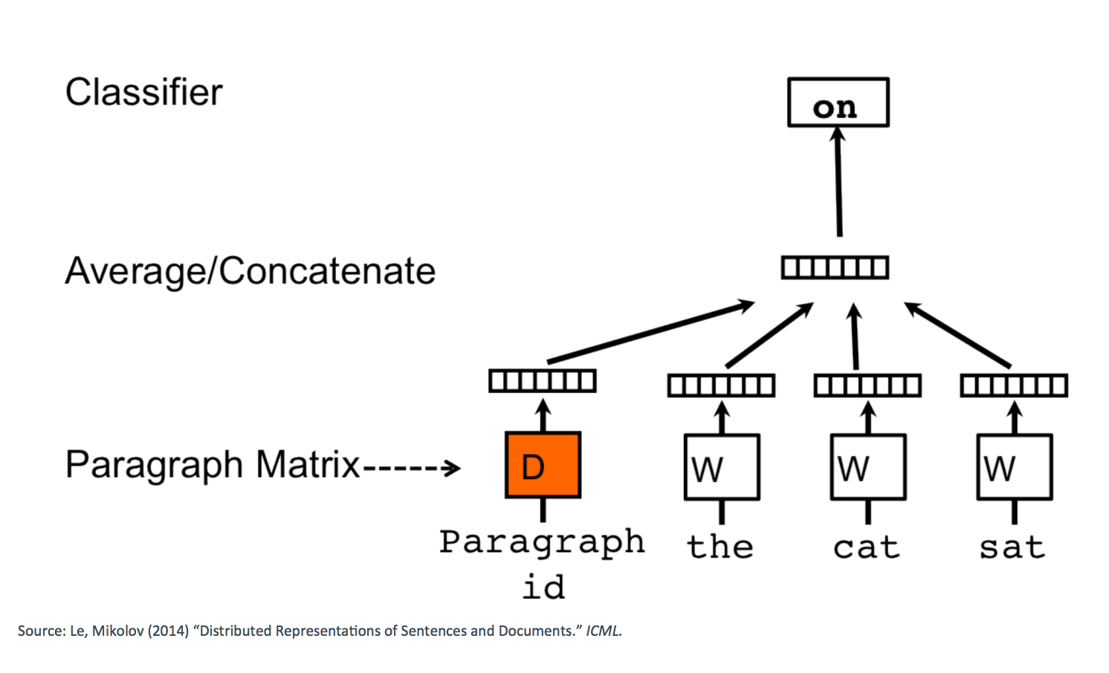

Doc2Vec

Slide 57
Doc2vec > Bag of Words
Semantic similarity
Takes into account word order within context
Similar to bag-of-words, but dense
Source: Le, Mikolov (2014) “Distributed Representations of Sentences and Documents.” ICML

Slide 58

dataset: Disaster
Rep: doc2vec
vis: PCA
separation is better!

Slide 59
Summary
Need some sort of vector representation to work with text quantitatively
search, similarity, classification, etc…
Traditional representations lose the semantics from context and position
Solution: Learn a representation by trying to predict words from their context (or vice versa)

Slide 60
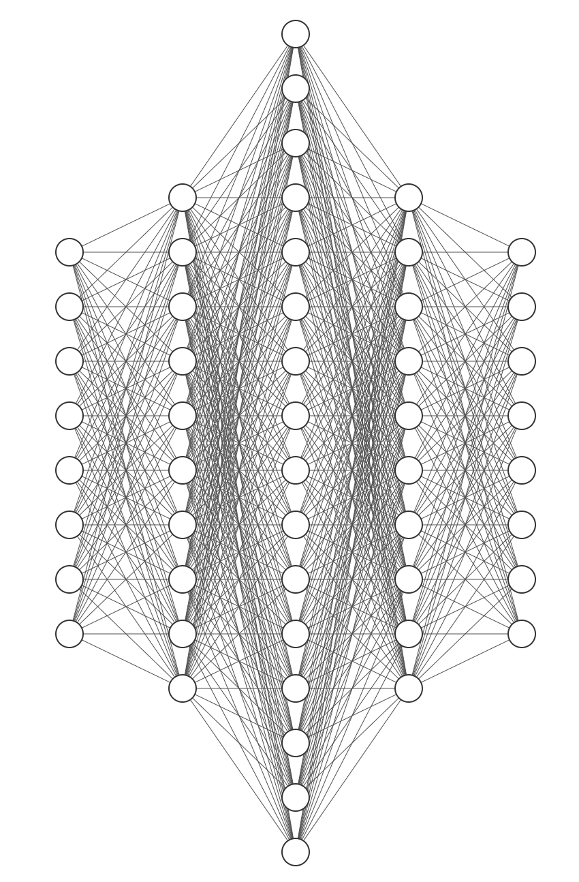
“The Mars Rover discovered organic molecules on Sunday”
Science
We can set up an end-to-end neural network that does everything
Notes:
Remember: Once we have “good” vectors, we can use any machine learning method, not necess

Slide 61
Recurrent Neural Networks

Slide 62
“The Mars Rover discovered organic molecules on Sunday”
Science
We can set up an end-to-end neural network that does everything
Notes:
Remember: Once we have “good” vectors, we can use any machine learning method, not necess

Slide 63
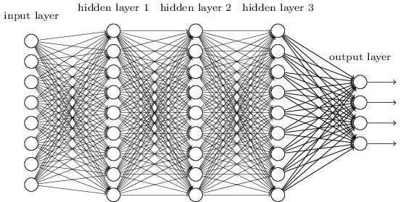
Embedding sequences
What can I do when input size and output size vary?

Slide 64
y₁
h₁
x₁

Slide 65
Sample Feed-forward Network
y₁
h₁
x₁
t = 1

Slide 66
Sample RNN
y₃
y₂
h₃
y₁
h₂
x₃
h₁
t = 3
x₂
x₁
t = 2
t = 1

Slide 67
Sample RNN
y₃
y₂
h₃
y₁
h₂
x₃
h₁
t = 3
x₂
h₀
t = 2
x₁
t = 1

Slide 68
The Vanilla RNN Cell
x_{t}
h_{t-1}
W
h_{t}

Slide 69
The Vanilla RNN Forward
C₁
C₂
C₃
y₁
y₂
y₃
x₁ h₀
x₂ h₁
h₁
x₃ h₂
h₂
h₃

Slide 70
The Vanilla RNN Forward
C₁
C₂
C₃
y₁
y₂
y₃
x₁ h₀
x₂ h₁
h₁
x₃ h₂
h₂
h₃
indicates shared weights
Essentially, copies of the RNN cell are made over time (unrolling/unfolding), with different inputs at different time steps

Slide 71
Sentiment Classification
Classify a restaurant review from Yelp! OR movie review from IMDB OR … as positive or negative
Inputs: Multiple words, one or more sentences
Outputs: Positive / Negative classification
“The food was really good”
“The chicken crossed the road because it was uncooked”

Slide 72
Sentiment Classification
RNN
h₁
The

Slide 73
Sentiment Classification
RNN
RNN
h₁
h₂
The
food

Slide 74
Sentiment Classification
h_{n}
RNN
RNN
RNN
h₁
h₂
h_{n-1}
The
food
good

Slide 75


Sentiment Classification
Linear Classifier
h_{n}
RNN
RNN
RNN
h₁
h₂
h_{n-1}
The
food
good

Slide 76
Sentiment Classification
Ignore
Ignore
Linear Classifier
h₁
h₂
h_{n}
RNN
RNN
RNN
h₁
h₂
h_{n-1}
The
food
good

Slide 77
Sentiment Classification
h = Sum(…)
h₁
h_{n}
h₂
RNN
RNN
RNN
h₁
h₂
h_{n-1}
The
food
good
http://deeplearning.net/tutorial/lstm.html

Slide 78
Sentiment Classification
Linear Classifier
h = Sum(…)
h₁
h_{n}
h₂
RNN
RNN
RNN
h₁
h₂
h_{n-1}
The
food
good
http://deeplearning.net/tutorial/lstm.html

Slide 79
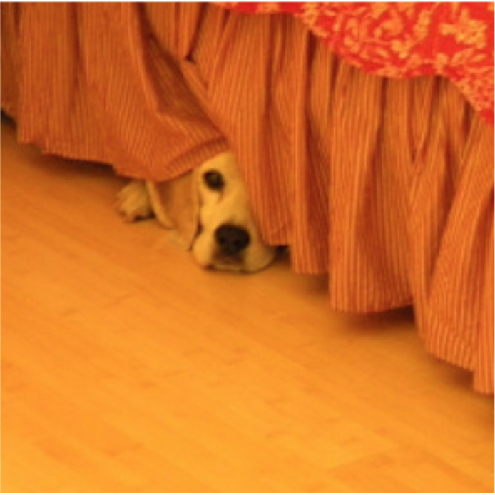
Image Captioning
Given an image, produce a sentence describing its contents
Inputs: Image feature (from a CNN)
Outputs: Multiple words (let’s consider one sentence)
: The dog is hiding

Slide 80
Image Captioning
RNN
CNN

Slide 81
Image Captioning
The
Linear Classifier
h₂
RNN
RNN
h₁
h₂
CNN

Slide 82
Image Captioning
The
dog
Linear Classifier
Linear Classifier
h₂
h₃
RNN
RNN
RNN
h₁
h₂
h₃
CNN

Slide 83
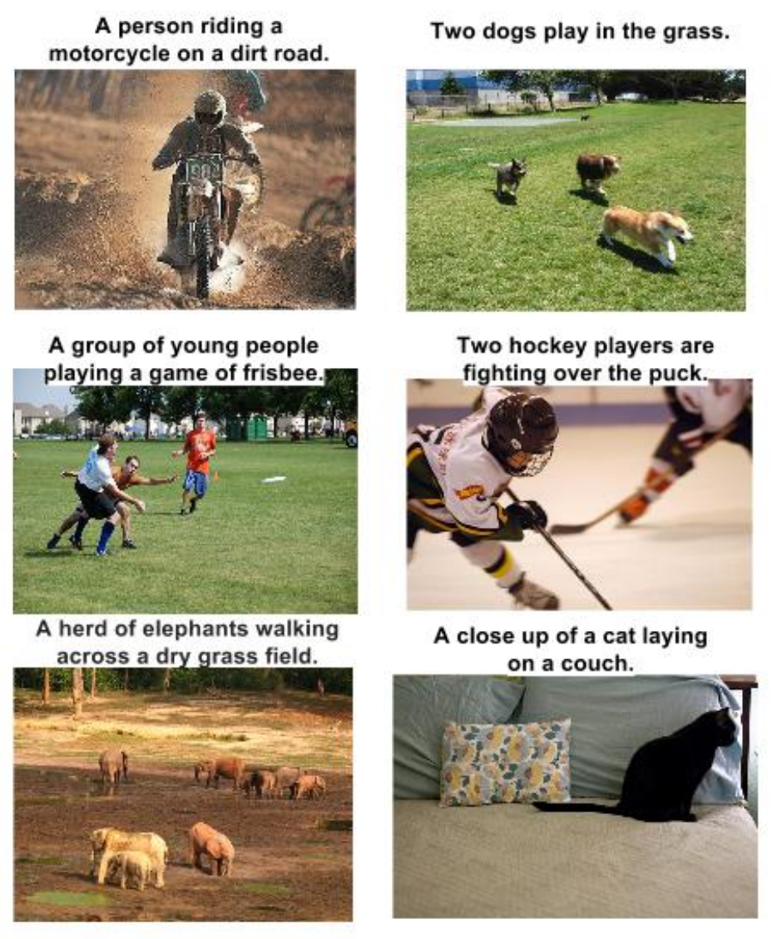
RNN Outputs: Image Captions
Show and Tell: A Neural Image Caption Generator, CVPR 15

Slide 84
RNN Outputs: Language Modeling
VIOLA:
Why, Salisbury must find his flesh and thought
That which I am not aps, not a man and in fire,
To show the reining of the raven and the wars
To grace my hand reproach within, and not a fair are hand,
That Caesar and my goodly father's world;
When I was heaven of presence and our fleets,
We spare with hours, but cut thy council I am great,
Murdered and by thy master's ready there
My power to give thee but so much as hell:
Some service in the noble bondman here,
Would show him to her wine.
KING LEAR:
O, if you were a feeble sight, the courtesy of your law,
Your sight and several breath, will wear the gods
With his heads, and my hands are wonder'd at the deeds,
So drop upon your lordship's head, and your opinion
Shall be against your honour.
http://karpathy.github.io/2015/05/21/rnn-effectiveness/

Slide 85
Input – Output Scenarios
Single - Single
Feed-forward Network
Single - Multiple
Image Captioning
Multiple - Single
Sentiment Classification
Multiple - Multiple
Translation
Image Captioning

Slide 86
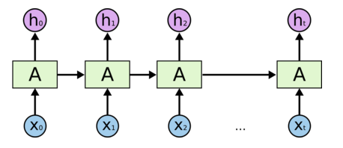
Architecture for an RNN
Some information is passed from one subunit to the next
Sequence of outputs
Sequence of inputs
Start of sequence marker
End of sequence marker
http://colah.github.io/posts/2015-08-Understanding-LSTMs/

Slide 87
Architecture for an 1980’s RNN
…
Problem with this: it’s extremely deep and very hard to train

Slide 88
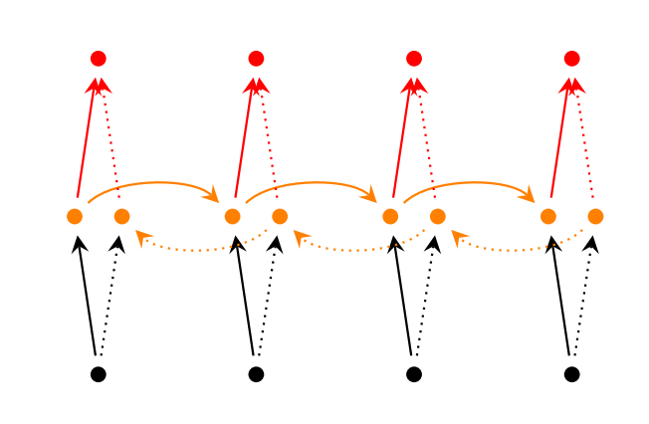
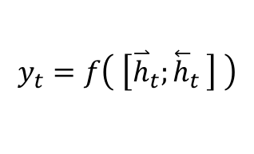
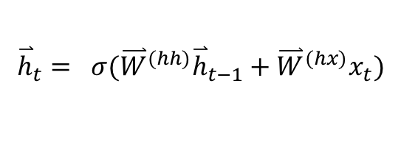
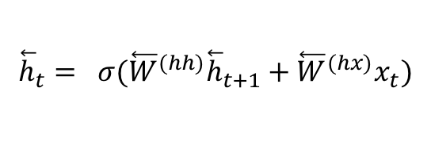
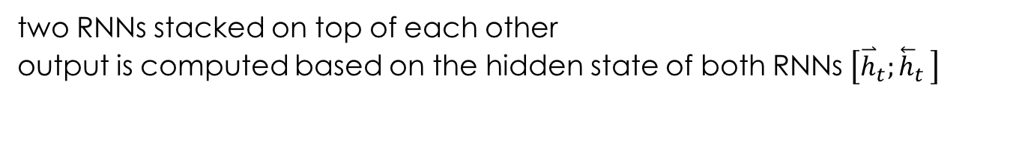
Bidirectional RNNs
Main idea: incorporate both left and right context
output may not only depend on the previous elements in the sequence, but also future elements.
$${\overset{⃑}{h}}_{t}= σ({\overset{⃑}{W}}^{(hh)}{\overset{⃑}{h}}_{t−1}+{\overset{⃑}{W}}^{(hx)}x_{t})$$
$${\overset{⃖}{h}}_{t}= σ({\overset{⃖}{W}}^{(hh)}{\overset{⃖}{h}}_{t+1}+{\overset{⃖}{W}}^{(hx)}x_{t})$$
$$y_{t}=f\left( \left[{\overset{⃑}{h}}_{t}{;\overset{⃖}{h}}_{t}\right] \right)$$
past and future around a single token
http://www.wildml.com/2015/09/recurrent-neural-networks-tutorial-part-1-introduction-to-rnns/
two RNNs stacked on top of each other
output is computed based on the hidden state of both RNNs $\left[{\overset{⃑}{h}}_{t}{;\overset{⃖}{h}}_{t}\right]$

Slide 89
Convolutional Approaches, again!

Slide 90
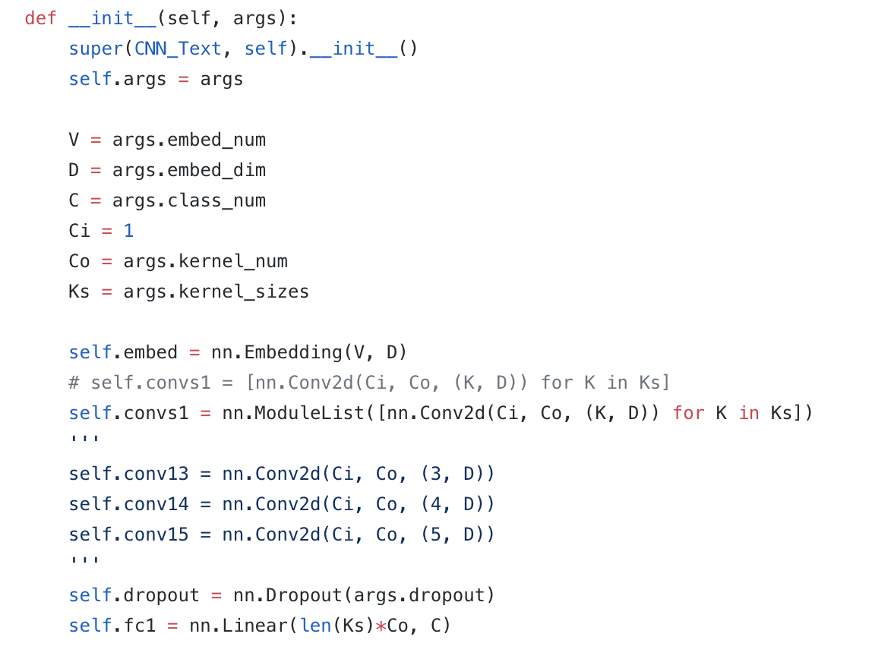
in pytorch
embedding layer
convolutional layers

